Slide 1
Washington Handbooks
If you have not yet done so, please pick up your child’s handbook and sign the sheet indicating your attendance and that you received your handbook.
Thank you.

Slide 2
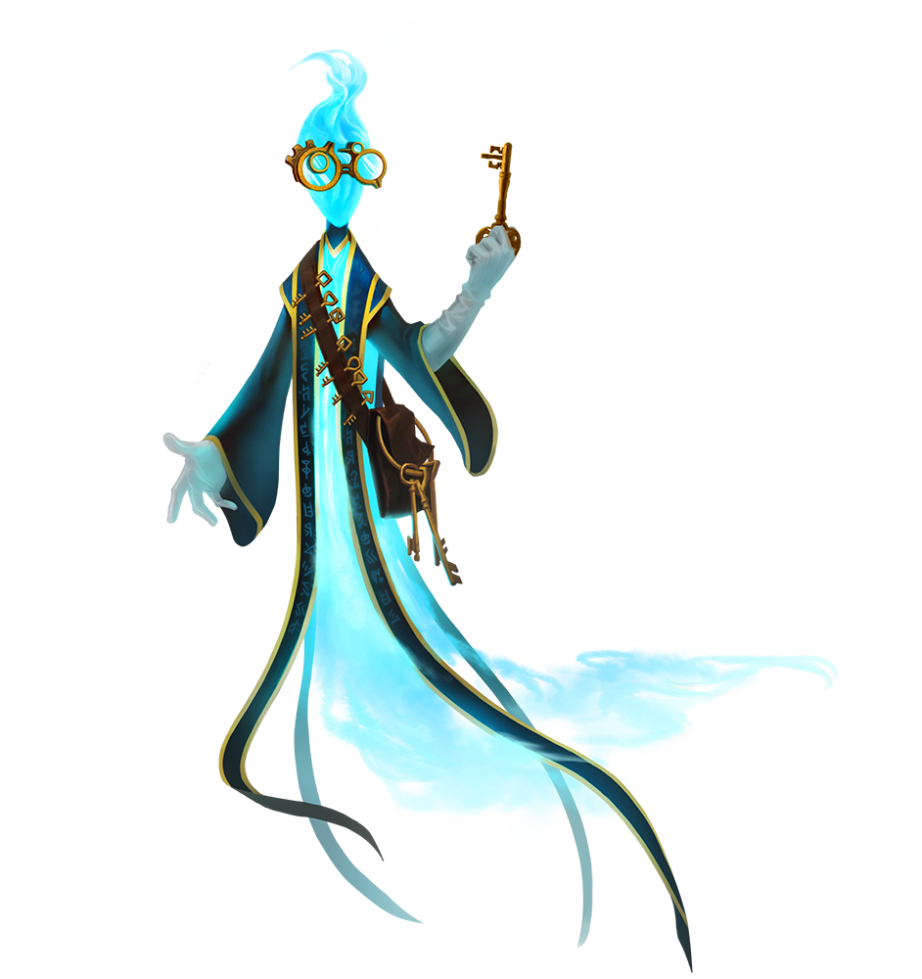
Parent Orientation
WELCOME TO 4BG
Thursday, August 28, 2018

Slide 3
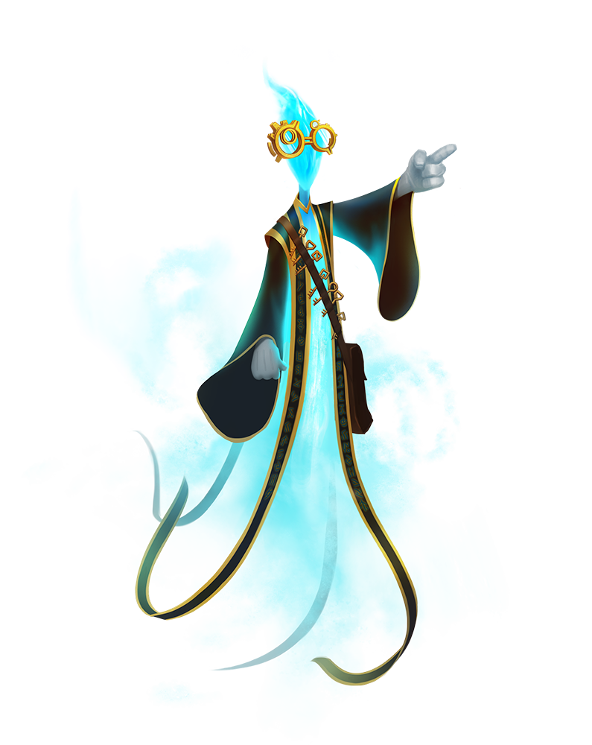
TESTING
PARCC
??????
MAP Testing
3 times a year
Dibels
3 times a year

Slide 4
Homework
practice-not for a grade
consistent format all year
completion for academic success
40 minutes
No signature required as long as students is responsible and ready with homework and planner

Slide 5
Science/Social Studies
Reading Common Core
Informational Texts
Next Generation Science Standards
Mystery Science and Defined STEM
CNN 10-current events and map skills
Assessments

Slide 6
Math
Common Core Standards
Daily Common Core Practice
Pre and post-tests
Unit packets
Basic Fact Tests/Special Activity
Small group work on individual skills
Differentiated and individualized practice on computers through the use of adaptive technology
Notes:
Go up to Assembly Room

Slide 7
Math Continued
Independent computer work
Moby Max Math Quarter Goals
DynaMath Monthly Magazine
Mini-Lessons
Game-Based Learning
MAP Testing
Enrichment Opportunities
Next Year

Slide 8
ELA(English Language Arts)
Common Core Standards
Storyworks
SRI, DIBELS, MAP testing
Fiction/Nonfiction texts
Scholastic Reading Counts (weekly quiz)
Mini lessons, individual conferences, and small groups

Slide 9
ELA cont.
Self-reflection sheet every two weeks
Daily writing in journal
Pattern sentences-sentence fluency
Moby Max Language-grammar rules
Words Their Way-no weekly spelling test
Assessments-rubrics on writing/class assignments
one-on-one conferences with students and small group work

Slide 10
Sign up Genius
class parties-healthy treats/popcorn/water
student-led conferences
look for emails as parties and conferences approach

Slide 11
Remind Communication Tool
Text messages from teachers for important events
Phone numbers are private
Great way to receive information quickly and efficiently

Slide 12
Birthdays, Celebrations, Field Trips
If your child would like to bring small treats to share for his/her birthday you can send non-food treats (gum, pencil, trinkets)
Halloween Parade, Winter Celebration, Valentine Exchange
New Salem - we will need volunteers for this one(background check)
End of the year bowling
50 Book Challenge-Gymnastics Etc.
Math Fact Bowling Trip
BHS Play and possibly a BCPA Play
Possibly more

Slide 13
Classcraft
Similar to Class Dojo
Gamifying the 4BG class
Encourages teamwork
Individual and group accountability
Parent access coming soon

Slide 14
4BG Weebly
Gruppbuob.weebly.com
Email Us at
buobj@district87.org and gruppj@district87.org

Slide 15
Supplies: Still need
Earbuds
Gallon sized bags
$5.00 for planner
Large Supply Box

Slide 16
Thank you for attending our 4BG Orientation Night
If we did not address any specific questions or concerns that you may still have, please feel free to email or call us and we will be happy to meet with you individually.

