Slide 1
Midwest Region

Slide 2
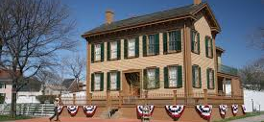
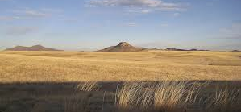
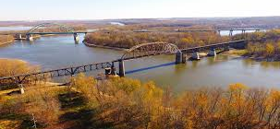
Illinois
Famous Landmark
Physical Features
Waterway
Lincoln home
Central plains
Shawnee hills
Illinois river
Lake Michigan

Slide 3
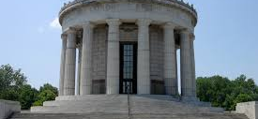
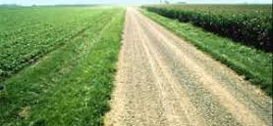
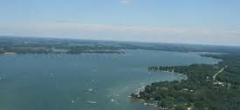
Indiana
Famous Landmark
Physical Features
Waterway
George Rogers Clark Memorial
Great lakes plains
Till plains
Ohio river
Lake wawasee

Slide 4
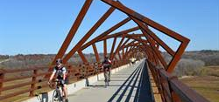
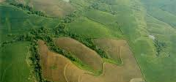
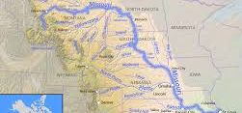
Iowa
Famous Landmark
Physical Features
Waterway
High trestle trail bridge
Young drift plains
Great plains
Mississippi river
Missouri river

Slide 5
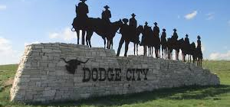
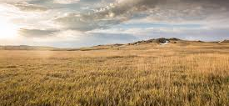
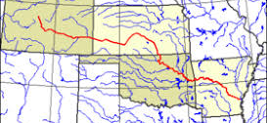
Kansas
Famous Landmark
Physical Features
Waterway
Dodge city sign
Southeastern plains
Great plains
Arkansas river
Lake michigan

Slide 6
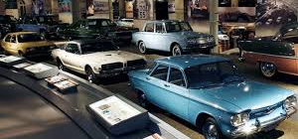
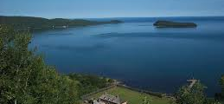
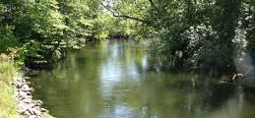
Michigan
Famous Landmark
Physical Features
Waterway
Henry ford museum
Superior upland
Great lakes plains
Kalamazoo river
Lake michigan

Slide 7
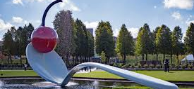
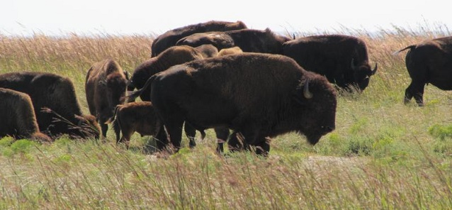
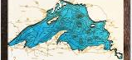
minnesota
Famous Landmark
Physical Features
Waterway
Spoonbridge and cherry
Central lowlands
Superior uplands
Minnesota river
Lake superior

Slide 8
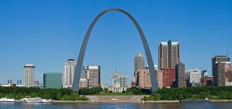
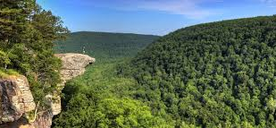
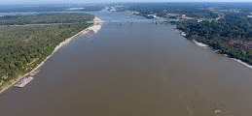
missouri
Famous Landmark
Physical Features
Waterway
Gateway Arch
Ozark plateau
Osage plains
Missouri river
Mississippi river

Slide 9
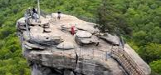

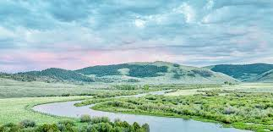
nebraska
Famous Landmark
Physical Features
Waterway
Chimney rock
Dissected till plains
Great plains
Platte river
Missouri river

Slide 10
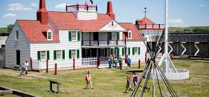
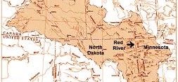
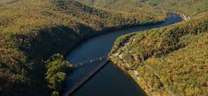
North dakota
Famous Landmark
Physical Features
Waterway
Fort union trading post
Red river valley
Great plains
James river
Red river

Slide 11

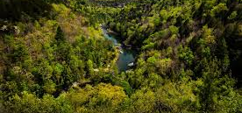

ohio
Famous Landmark
Physical Features
Waterway
Rock and roll hall of fame
Great lakes plains
Appalachian plateau
Ohio river
Lake erie

Slide 12
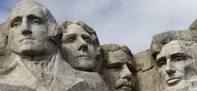
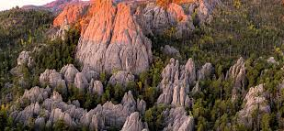
South dakota
Famous Landmark
Physical Features
Waterway
Mount rushmore
Black hills
Great plains
James river
Missouri river

Slide 13
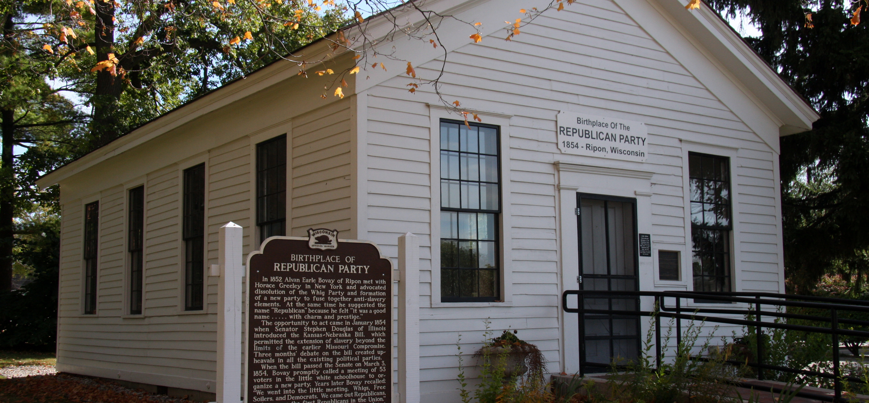
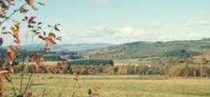
wisconsin
Famous Landmark
Physical Features
Waterway
Little white schoolhouse
Eastern lowlands
Northern highland
Mississippi river
Lake superior

